Slide 1
WEEK 6· GATE 6 ASSESSMENT
ShopKart
Test Automation
PREPARED BY
Muhammed Ali M A
Project GitHub link
muhammedalima-ust/week6Assessment

Slide 2
CONTENTS
Agenda
01
The Framework
Layered structure — config, API, UI, data, steps
02
Six Scenarios
Search, cart, checkout, access, cancel, stock
03
Test Report
Allure Report
04
Conclusion
What Improvement the framework provide
2

Slide 3
01
The Framework
config
api
No Hardcoded Data – Everything is getting from ci or local secrets or env
One Rest Client for Each Api : Order, Product, Cart, Auth
ui
data
Page Object Model + Xpath Locators
Builders for Test Data and Records models to support builders
steps
support
Different Steps file for each flows
Shared World Class , Common Hooks with screenshot on failure and Allure Steps and Log for tracing
3

Slide 4
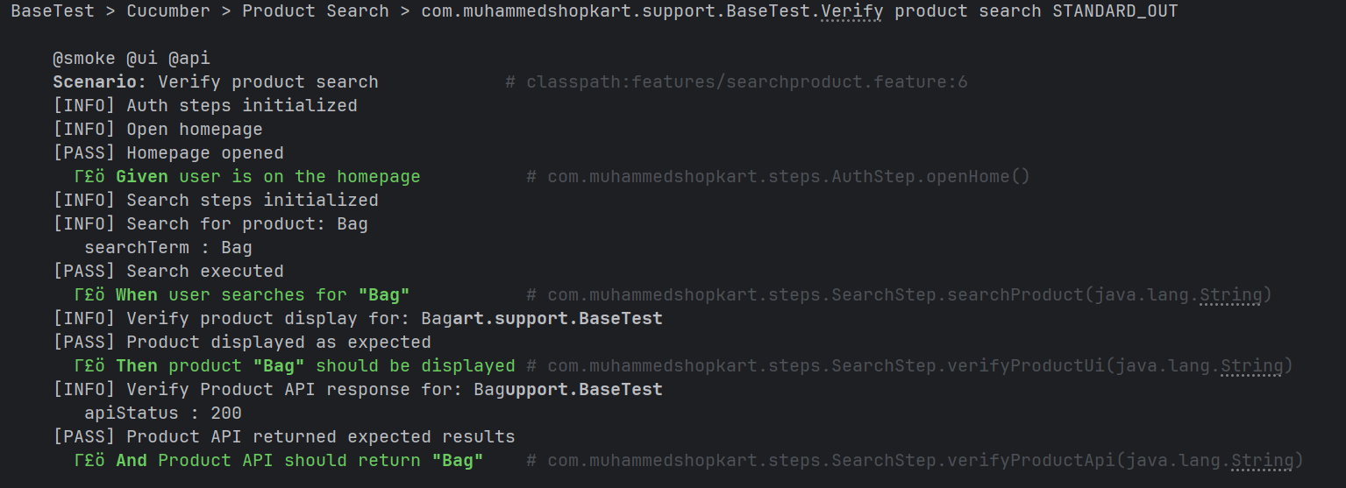
02.1
@SMOKE @UI @API
Product Search
PROVES
Search returns matching products, verified in both the UI and the API response.
A customer types a partial name; the results grid and the /api/products response are checked against the same expectation, so a UI-only bug and an API-only bug are both caught.
4

Slide 5
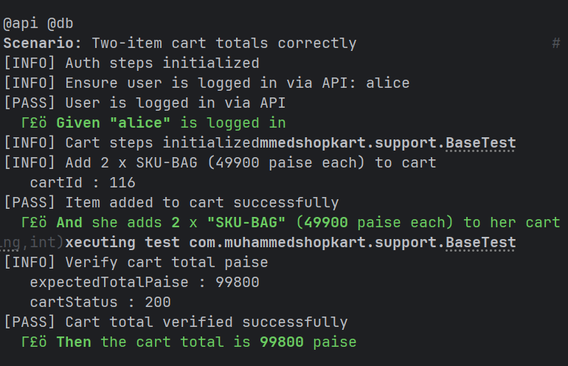
02.2
@API @DB
Cart Totals
PROVES
Total equals the sum of quantity × price, in paise, and the database agrees.
HOW IT RUNS
Items are added through the cart API; the returned total is checked against a computed expectation, then the database is queried directly to confirm the same figure — one fact, two sources.
5

Slide 6
02.3
@E2E @SMOKE
Checkout — Flagship E2E
PROVES
Login → search → add → cart → checkout ends in a PLACED order, proven three ways.
HOW IT RUNS
The UI shows the confirmation, the API returns the same order and total, and the orders table holds exactly one PLACED row. The password is never in the feature file — it's resolved at run time.
6

Slide 7
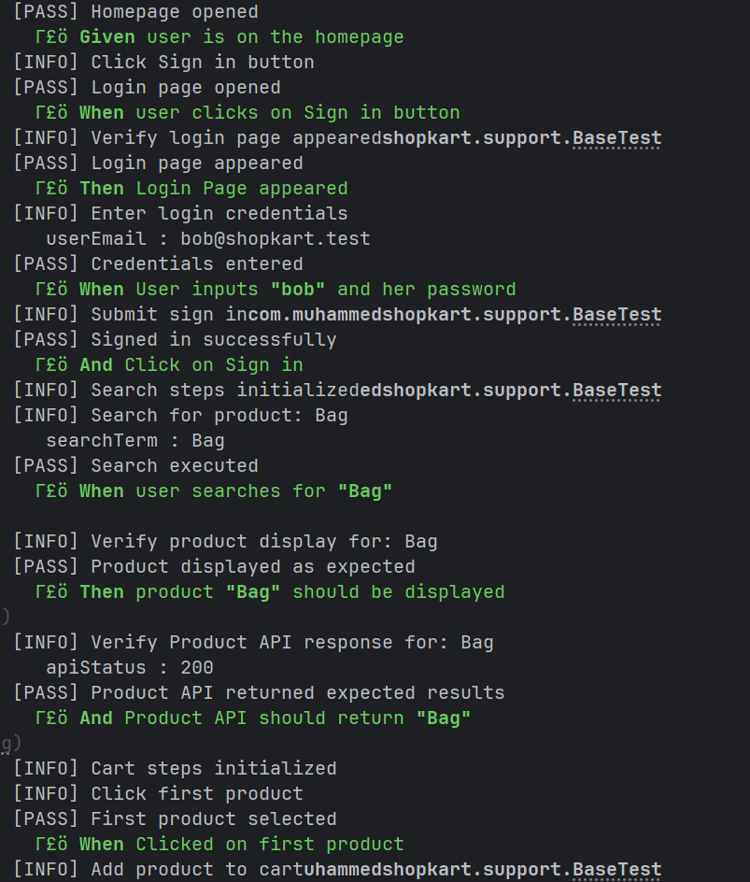
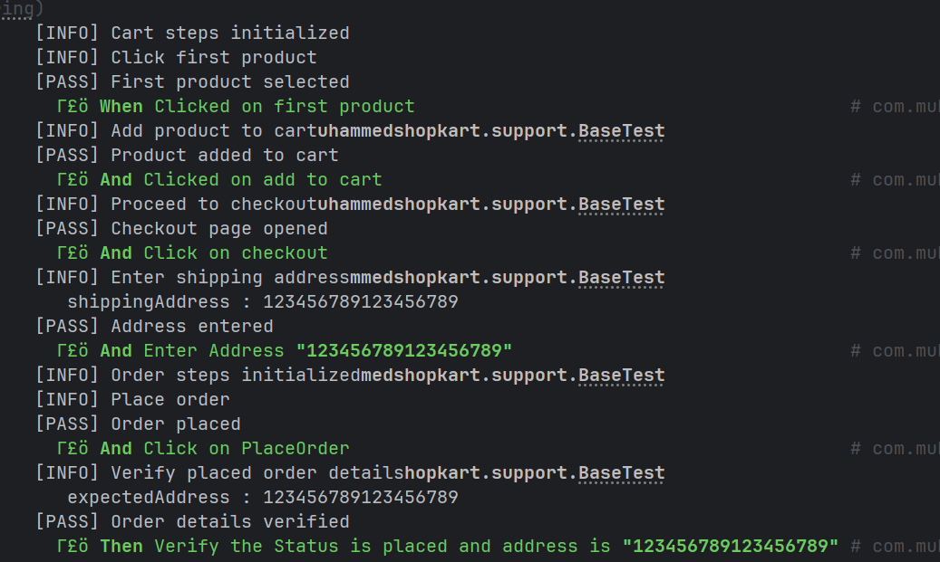
02.3
@E2E @SMOKE
Checkout — Flagship E2E
PROVES
Login → search → add → cart → checkout ends in a PLACED order, proven three ways.
HOW IT RUNS
The UI shows the confirmation, the API returns the same order and total, and the orders table holds exactly one PLACED row. The password is never in the feature file — it's resolved at run time.
LAYERS
UI → API → DB
ShopKart / SDET Capstone
6

Slide 8
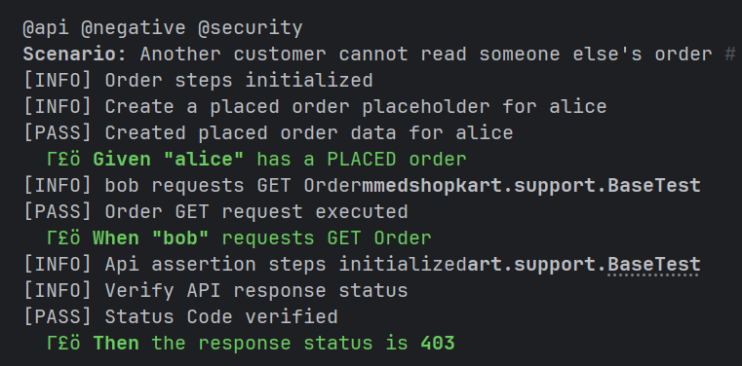
02.4
@API @NEGATIVE @SECURITY
Order Access
PROVES
Object-level authorization: another customer gets 403.
HOW IT RUNS
A second, unrelated customer requests someone else's order by ID. The suite asserts a clean 403 and confirms no order data leaks into the response.
LAYERS
API · Negative
ShopKart / SDET Capstone
7

Slide 9
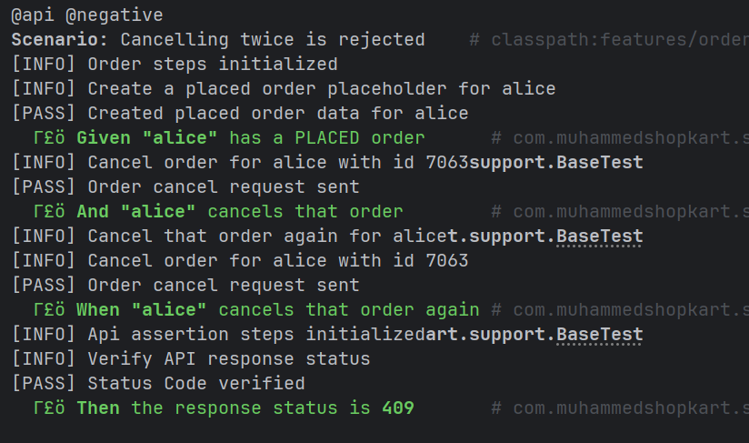
02.5
@API @NEGATIVE
Cancel Rules
PROVES
A PLACED order can be cancelled once; a second attempt correctly fails.
HOW IT RUNS
Cancel the order again will return 409.
LAYERS
API · DB
ShopKart / SDET Capstone
8

Slide 10
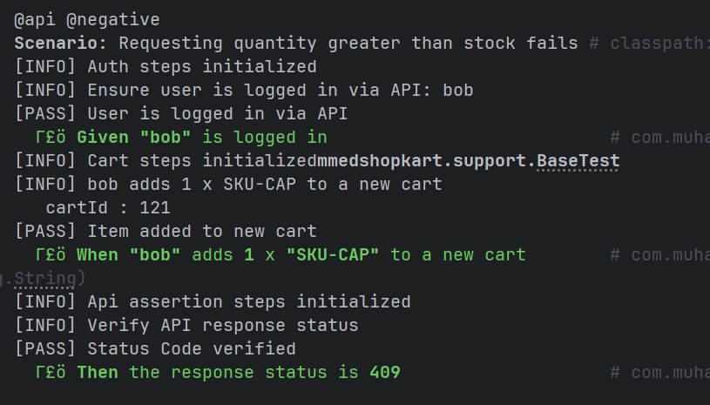
02.6
@API @NEGATIVE
Out of Stock
PROVES
Requesting more units than are in stock is rejected with 409, never a partial fulfilment.
HOW IT RUNS
Using a seeded zero-stock SKU, the suite adds a quantity above availability and confirms the API refuses cleanly, protecting inventory integrity.
LAYERS
API · Negative
ShopKart / SDET Capstone
9

Slide 11
03
PART THREE
Test Report
evidence, not opinion
History
Categories
When the code run in CI it will store the history in the branch gh-page and also added to the allure using github action we can upload the history
Failures bucket automatically into product defect, test defect, or flaky.
Executive view
NO test failed every test gives a green
10

Slide 12
PART FOUR
Conclusion
Structure holds
Every layer is proven
Security is tested, not assumed
Reporting tells the truth
Thank You …!
11

